Slide 1

DriverPass System Analysis
Oumar Kenneh
Notes:
[No speaker notes required for this slide.]

Slide 2

System Requirements
Functional Needs – Online account creation and login – Lesson scheduling and cancellation – Practice tests and progress tracking – DMV data integration – Reporting for staff and management
Nonfunctional Needs – Cloud hosting for easy access – Secure data exchange and password control – Fast and reliable performance for many users at once – Web browser compatibility and scalable design
Notes:
DriverPass require the one solution that provides student driver learning, and intuitive book-and-go lessons as well as the staff management of accounts and reporting. The system also must be fast, secure and adaptable to scale as future updates are released.

Slide 3
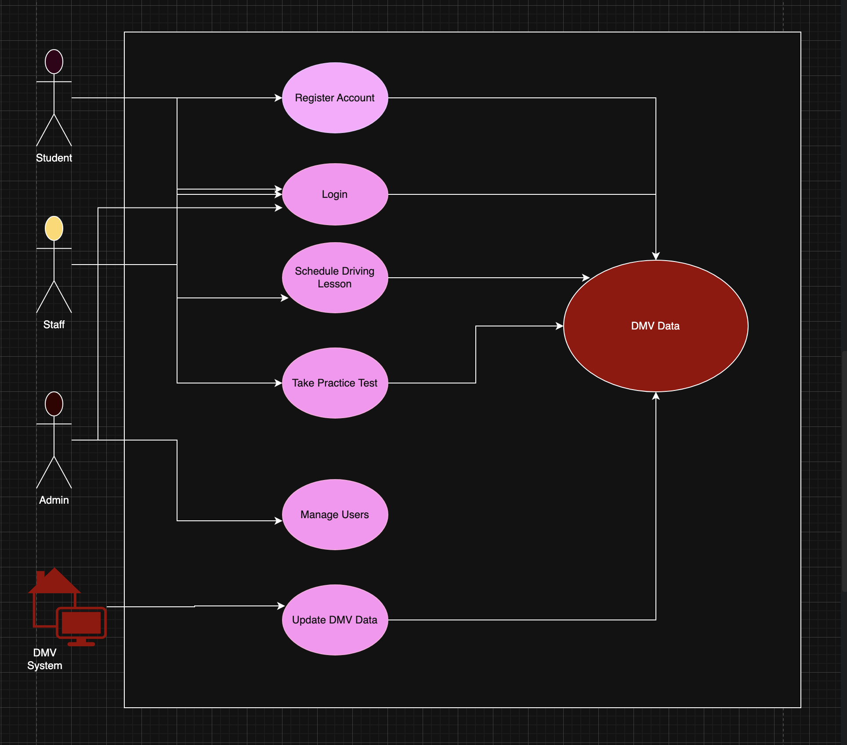
Use Case Diagram
[Insert your use case diagram here.]
Notes:
This diagram shows how each user type interacts with the system. A student logs on to the site in order to register, schedule lessons and take tests. Employees confirm reservations and deal with reschedules, the ITadministrator is in charge of information and security. The DMVconnection maintains the test content and questions so the information is up to date and valid.

Slide 4
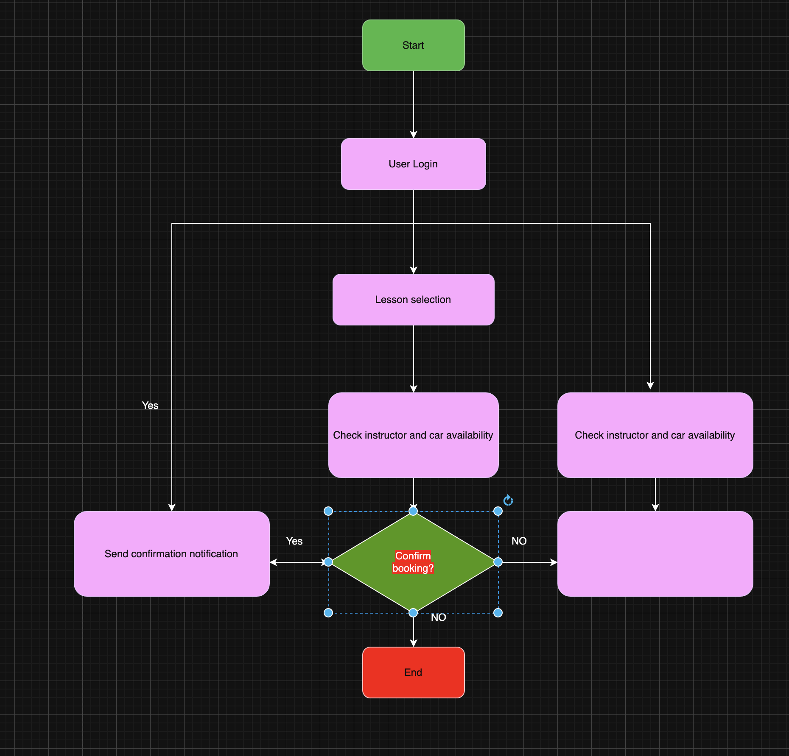
Activity Diagram
[Insert one of your activity diagrams here.]
Notes:
This activity diagram describes in detail how a booking is processed from beginning to end. It starts with logging in, and it finishes by clicking at the end. Every decision point eliminates scheduling mistakes and keeps student/instructor availability current.

Slide 5
Security
User authentication and unique
logins
Encrypted data for payments and personal records
Activity logs to track changes
Automatic password reset and
access revocation
Notes:
All aspects of DriverPass are secure by design. All transactions are authenticated, and sensitive information moves through secure channels. Logging helps maintain an audit trail of all changes, and admins can also immediately disable or recover accounts to prevent business disruption.

Slide 6
System Limitations
Offline editing not supported (except exporting reports)
Lesson availability depends on drivers and cars
Some features require external APIs (DMV updates, payment processing)
Future expansions may require additional development time
Notes:
DriverPass system works best when it is online. As lessons are based on actual scheduling and DMV links, certain content requires outside services or staff availability. Such limitations are inherent feature of such systems and would be closely controlled to maintain the level of reliability.

